Slide 1


Designing Network Security and Privacy Mechanisms: How Game Theory Can Help
GameSec 2010
Jean-Pierre Hubaux
EPFL
With contributions (notably) from
J. Freudiger, H. Manshaei, P. Papadimitratos, M. Poturalski, and M. Raya

Slide 2
Wireless Networks
Many deployment scenarios
Spectrum is a scarce resource ➔ Potential strategic behavior of individual devices or network operators
Paradise for game theorists ?

Slide 3
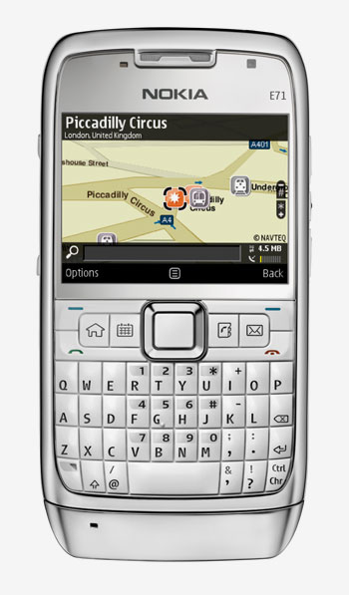
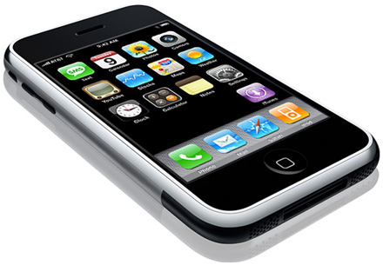
Modern Mobile Phones
Quad band GSM
(850, 900, 1800, 1900 MHz)
GPRS/EDGE/HSDPA
Tri band UMTS/HSDPA
(850, 1900, 2100 MHz) Soon LTE
GPS + accelerometers
WiFi (802.11b/g)
Bluetooth
P2P wireless
Nokia: NIC
Qualcomm: Flashlinq
WiFi-Alliance: Wi-Fi Direct
iPhone
Notes:
3

Slide 4

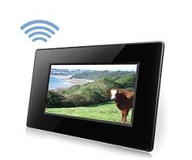
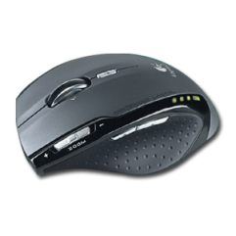

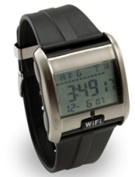
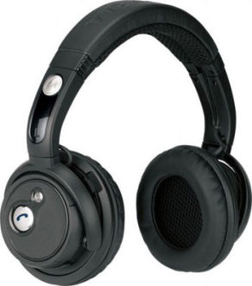
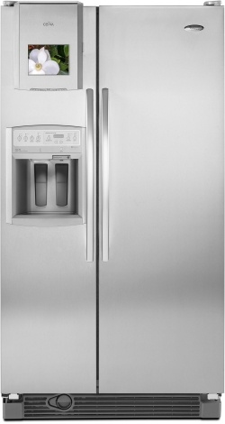
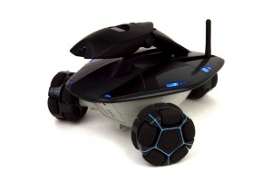
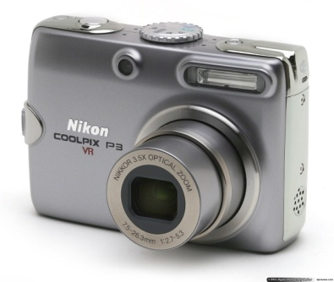
Wireless Enabled Devices
Notes:
4

Slide 5
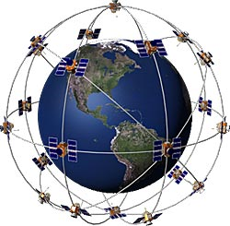
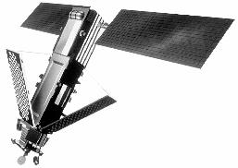
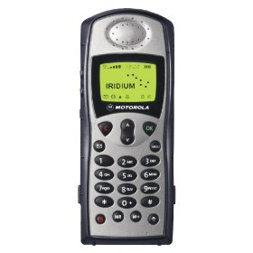
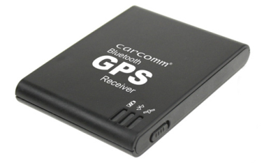
Satellite Communications
Iridium Satellite
Supports 1100 concurrent phone calls
Orbit altitude: approx. 780 km
Frequency band: 1616-1626.5 MHz
Rate: 25 kBd
FDMA/TDMA
Global Positioning System (GPS)
Orbit altitude: approx. 20,200 km
Frequency: 1575.42 MHz (L1)
Bit-rate: 50 bps
CDMA
Iridium 9505A Satellite Phone
BTCC-45 Bluetooth GPS Receiver
Notes:
5

Slide 6
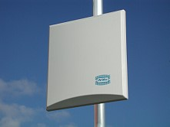

Wireless “Last Mile”: WiMax
WiMAX GP3500-12 omnidirectional antenna
Frequency band: 3400-3600 MHz
Gain: 12 dBi
Impendence: 50 Ω
Power rating: 10 Watt
Vertical beam width: 10°
WiMAX PA3500-18 directional antenna
Frequency band: 3200-3800 MHz
Gain: 12 dBi
Impendence: 50 Ω
Power rating: 10 Watt
Vertical beamwidth: 17°
Horizontal beamwidth: 20°
Notes:
6

Slide 7
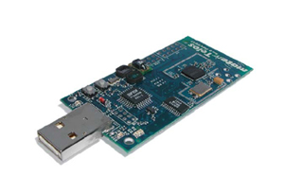
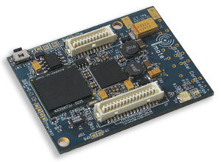
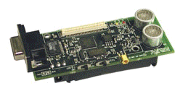
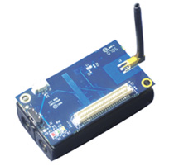
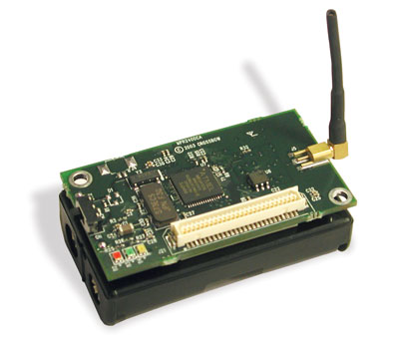
Wireless Sensors
Imote2
Cricket Mote
TelosB Sensor Mote
Iris Mote
IEEE 802.15.4 Chipcon Wireless Transceiver
Frequency band: 2.4 to 2.4835 GHz
Data rate: 250 kbps
RF power: -24 dBm to 0 dBm
Receive Sensitivity: -90 dBm (min), -94 dBm (typ)
Range (onboard antenna): 50m indoors / 125m outdoors
MicaZ
Notes:
7

Slide 8
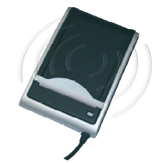
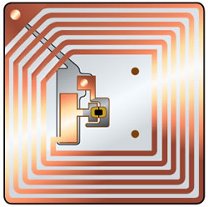
Radio-Frequency Identification (RFID)
SDI 010 RFID Reader
ISO14443-A and B (13.56 MHz)
Operating distance: 1cm
Communication speed: up to 848 Kbit/s
RFID tag
Notes:
8

Slide 9

Medical Implants
Implantable Cardioverter Defibrillator (ICD)
Operating frequency: 175kHz
Range: a few centimeters
Medical Implant Communication Service (MICS)
Frequency band: 402-405 MHz
Maximum transmit power (EIRP): 25 microwatt
Range: a few meters
Notes:
9

Slide 10
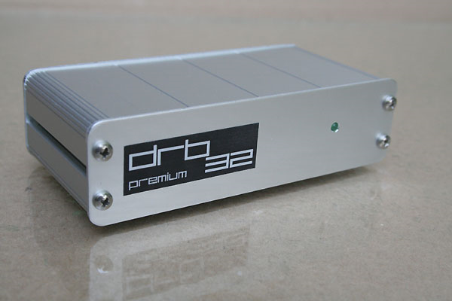
Software Defined Radio
Tuning Frequency:
30KHz - 30MHz (continuous)
Tuning Steps:
1/5/10/50/100/500Hz & 1/5/9/10KHz
Antenna Jacket / Impedance:
BNC-socket / 50Ohms
Max. Allowed Antenna Level :
+10dBm typ. / saturation at -15dBm typ.
Noise Floor (0.15-30MHz BW 2.3KHz):
Standard: < -131dBm (0.06μV) typ.
HighIP: < -119dBm (0.25μV) typ.
Frequency Stability (15min. warm-up
period):
+/- 1ppm typ.
Application: Cognitive Radios ➔ Dynamic Spectrum Access
Notes:
10

Slide 11
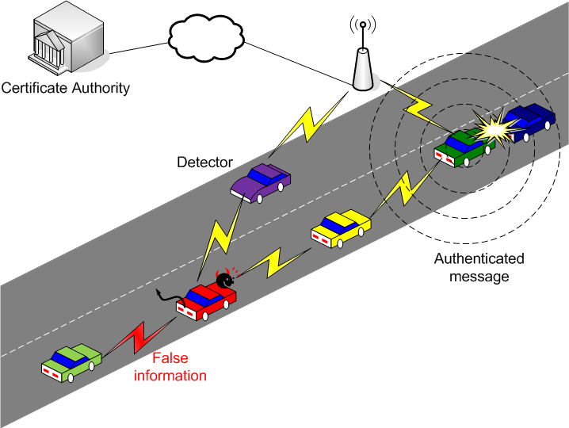
Vehicular Communications
Dedicated short-range communications (DSRC)
Frequency band (US): 5.850 to 5.925 GHz
Data rate: 6 to 27 Mbps
Range: up to 1000m
Notes:
11

Slide 12
Question
Would you model wireless devices / network operators by cooperative or non-cooperative games?
Back to the fundamentals…

Slide 13
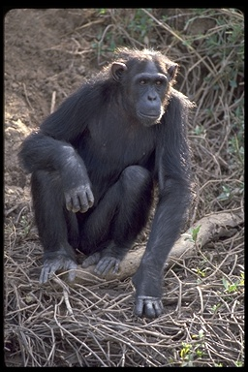
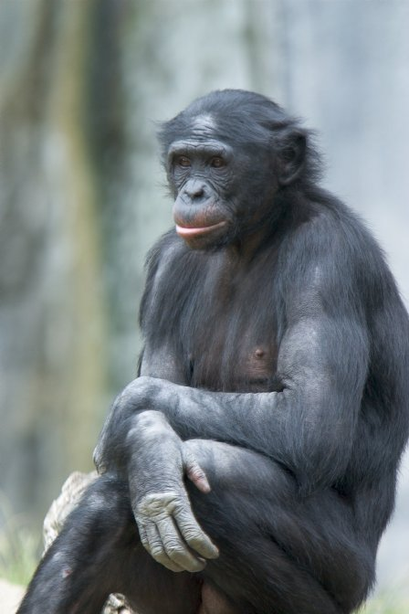
(Non)-Cooperative behavior in wireless networks: bonobos Vs chimps
Chimpanzee
www.ncbi.nlm.nih.gov
Bonobo
www.bio.davidson.edu

Slide 14
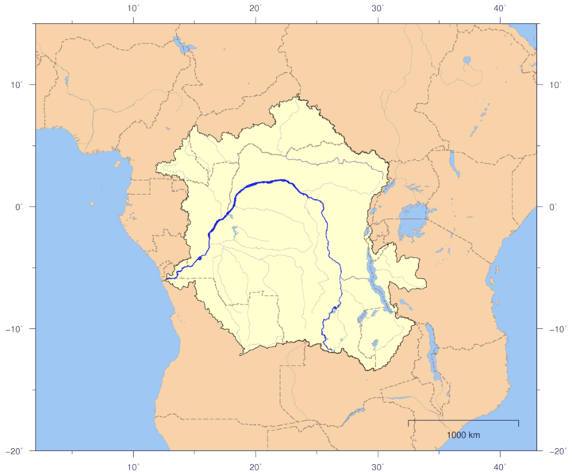
Living places (very simplified)
Chimps
Congo river
Bonobos

Slide 15
Cross-layer design…
Non-
Cooperative
(or “selfish”)
Upper layers (MAC and above)
Chimps
Congo river
Cooperative
Bonobos
Physical layer

Slide 16

Cooperation between wireless devices (at the physical layer)
S
D
S
D
R
Cooperative relaying
Cooperative beamforming

Slide 17

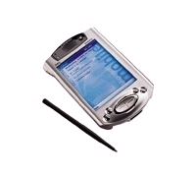

Non-cooperation between wireless devices (MAC and network layer)
X
At the network layer
Note: sometimes non-cooperation is assumed at the physical layer; likewise, cooperation is sometimes assumed at the upper layers
Well-behaved node
Well-behaved node
Cheater
At the MAC layer

Slide 18

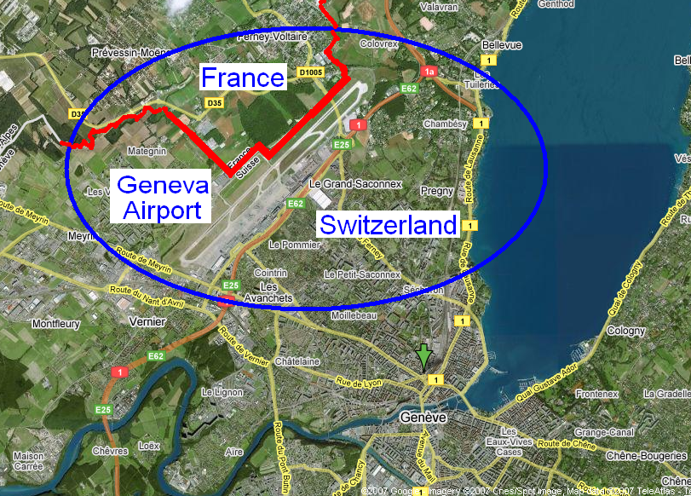
(Non-)cooperation between wireless networks: cellular operators in shared spectrum
X

Slide 19


More on primatology

Slide 20
Dynamic Spectrum Allocation
Rationale: wireless devices becoming very sophisticated ➔ ``Command and Control´´ allocation of the spectrum obsolete ➔ Less regulation !!!
Each device / each operator is a selfish agent
The market determines (in real time) the best usage of the spectrum
Already a modest realization in the ISM band (for WiFi)
IEEE DySPAN: Dynamic Spectrum Access Networks
But isn’t this rather lawyers’ paradise?
Skepticism of regulators

Slide 21
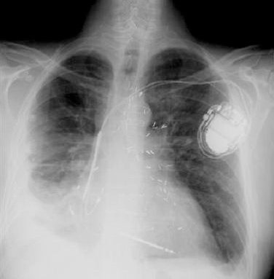
Vulnerabilities of Wireless Devices…
… to malicious behavior
… and to selfish behavior
A Heart Device Is Found
Vulnerable to Hacker Attacks
Power games in shared spectrum
(or between cognitive radios)
Example in the Internet: spam
Example in the Internet: viruses

Slide 22
Malice Vs Selfishness
Security/crypto
Manichean world
Some parties are trusted, some not
Attacker’s behavior is arbitrary
Attacker’s model (e.g., Dolev-Yao)
Strength of the attacker
Game theory
All players are selfish
Payoff / Utility function
Strategy space
Information
Agreements
Solution of the game
Mechanism design

Slide 23



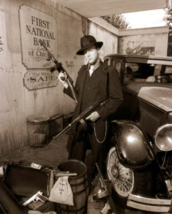
Who is malicious? Who is selfish?
Harm everyone: viruses,…
Big brother
Selective harm: DoS,…
Spammer
Cyber-gangster:
phishing attacks,
trojan horses,…
Greedy operator
Selfish mobile station
There is no watertight boundary between malice and selfishness
➔ Both security and game theory approaches can be useful

Slide 24
Game Theory Applied to Security Problems
Security of Physical and MAC Layers
Anonymity and Privacy
Intrusion Detection Systems
Security Mechanisms
Cryptography
…

Slide 25


Security of Physical and MAC Layers
S
W
Players (Ad hoc or Infrastructure mode):
Well-behaved (W) wireless modes
Selfish (S) - higher access probability
Malicious (M) - jams other nodes (DoS)
Objective: Find the optimum strategy against M and S nodes
Reward and Cost: Throughput and Energy
Game model: A power-controlled MAC game solved for
Bayesian Nash equilibrium
Game results: Introduce Bayesian learning mechanism
to update the type belief in repeated games
M
W
S
Optimal defense mechanisms against denial of service attacks in wireless networks
Y.E. Sagduyu, R. Berry, A. Ephremides, “MAC games for distributed wireless network security with incomplete information of selfish and malicious user types,” GameNets 2009.

Slide 26
Economics of Anonymity
Traffic to be anonymized
Mix-net
Agent
Rationale: decentralized anonymity infrastructures still not in wide use today
In the proposed model, an agent can decide to:
act as a simple user (sending her own traffic + possibly dummy traffic)
act as a node (receiving and forwarding traffic, keeping messages secret, and possibly creating dummy traffic)
send messages through conventional, non-anonymous channels
Model as a repeated-game, simultaneous-move game
Global passive adversary
A. Acquisti, R. Dingeldine, P. Syverson. On the economics of anonymity. FC 2003
T. Ngan, R. Dingledine, D. Wallach. Building incentives into Tor. FC2010
N. Zhang et al. gPath: a game-theoretic path selection algrithm to prtect Tor’s anonymity GameSec 2010

Slide 27
Intrusion Detection Systems
Subsystem 1
Attacker
Subsystem 2
Subsystem 3
Players: Attacker and IDS
Strategies for attacker: which subsystem(s) to attack
Strategies for defender: how to distribute the defense mechanisms
Payoff functions: based on value of subsystems + protection effort
T. Alpcan and T. Basar, “A Game Theoretic Approach to Decision and Analysis in Network Intrusion Detection”, IEEE CDC 2003

Slide 28
Cryptography Vs. Game Theory
Issue | Cryptography | Game Theory
Incentive | None | Payoff
Players | Totally honest/ malicious | Always rational
Punishing cheaters | Outside the model | Central part
Solution concept | Secure protocol | Equilibrium
Y. Dodis, S. Halevi, T. Rubin. A Cryptographic Solution to a Game Theoretic Problem.
Crypto 2000
See also S. Izmalkov, S. Micali, M. Lepinski. Rational Secure Computation and Ideal Mechanism Design, FOCS 2005

Slide 29
Crypto and Game Theory
Design crypto mechanisms with rational players
Example: Rational Secret Sharing and Multi-Party Computation
Halpern and Teague, STOC 2004
Game Theory
Cryptography
Implement GT mechanisms in a distributed fashion
Example: Mediator (in correlated equilibria)
Dodis et al., Crypto 2000

Slide 30
Design of Cryptographic Mechanisms with Rational Players: Secret Sharing
Reminder on secret sharing
a. Share issuer
b. Share distribution
S1
Agent 1
S3
S2
Agent 2
S1
S3
Secret
S2
Agent 3
c. Secret reconstruction
Agent 1
S1
S2
Agent 2
Agent 3
S3

Slide 31
The Temptation of Selfishness in Secret Sharing
Agent 1
S1
Agent 1 can reconstruct the secret
Neither Agent 2 nor Agent 3 can
S2
Agent 2
Agent 3
S3
Model as a game:
Player = agent
Strategy: To deliver or not one’s share (depending on what the other players did)
Payoff function:
a player prefers getting the secret
a player prefers fewer of the other get it
Impossibility result: there is no simple mechanism that would prevent this ➔ Proposed solution: randomized mechanism

Slide 32
Randomized Protocol (for 3, simplified)
d₂
Protocol for agent 1:
Toss coin b1
Toss coin c1L
Set c1R = b1 ⊕ c1L
Send c1L left, c1R right
Send d1 = b1 ⊕ c3L left
Compute b1⊕b2⊕b3 = b1⊕c2R⊕d3
If b1=b1⊕b2⊕b3 = 1, send share.
If received shares or detected cheating, quit. Else restart protocol with new share.
Main result: a rational agent will follow the protocol
2
3
c_{3R}
c_{2L}
c_{1L}
c_{3L}
c_{2R}
c_{1R}
d₃
d₁
1
Courtesy J. Halpern and V. Teague
J. Halpern and V. Teague. Rational Secret Sharing and Multi-Party Computation.
STOC 2004

Slide 33
Improving Nash Equilibria (1/2)
Player 2
Chicken
Dare
Chicken
4, 4 | 1, 5
5, 1 | 0, 0
Player 1
Dare
3 Nash equilibria: (D, C), (C, D), (½ D + ½ C, ½ C+ ½ D)
Payoffs: [5, 1] [1, 5] [5/2, 5/2]
The payoff [4, 4] cannot be achieved without a binding contract, because it is not an equilibrium
Possible improvement 1: communication
Toss a fair coin → if Head, play (C, D); if Tail, play (D, C) → average payoff = [3, 3]
Y. Dodis, S. Halevi, and T. Rabin. A Cryptographic solution to a game theoretic problem, Crypto 2000

Slide 34
Improving Nash Equilibria (2/2)
Player 2
Chicken
Dare
Chicken
4, 4 | 1, 5
5, 1 | 0, 0
Player 1
Dare
Possible improvement 2: Mediator
Introduce an objective chance mechanism: choose V1, V2, or V3 with probability 1/3 each. Then:
Player 1 is told whether or not V1 was chosen and nothing else
Player 2 is told whether or not V3 was chosen and nothing else
If informed that V1 was chosen, Player 1 plays D, otherwise C
If informed that V3 was chosen, Player 2 plays D, otherwise C
This is a correlated equilibrium, with payoff [3 1/3, 3 1/3]
It assigns probability 1/3 to (C, C), (C, D), and (D, C) and 0 to (D, D)
How to replace the mediator by a crypto protocol: see Dodis et al.

Slide 35
An Example of Security (or rather, Privacy) Mechanism Modeled by Game Theory: Cooperative Change of Pseudonyms in Mix Zones
J. Freudiger, H. Manshaei, JP Hubaux, D. Parkes
On Non-Cooperative Location Privacy: A Game-Theoretic Analysis

Slide 36
Location Privacy with Mix Zones
1
1
b
?
1
2
2
a
Mix zone
Notes:
Notion of cooperation

Slide 37

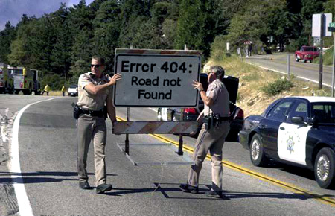

“Costs” generated by Mix Zones
Turn off transceiver
Routing is difficult
Load authenticated pseudonyms
+
+
=

Slide 38
Sequence of Pseudonym Change Games
E₁
E₂
7
E₃
4
8
1
5
6
3
2
9
u_{i}
A_{i}(t₁)- γ
A_{i}(t₂)- γ
γ
E₁
E₂
E₃

Slide 39
Non-Cooperative Behavior
Benefit B of mix zone:
Location Privacy
Strategies
Cooperate: Change identifier in the mix zone
Defect: Do not change
Depend on current level of location privacy of nodes
Cost C of mix zone :
Mobiles must remain silent
Mobiles must change their identifier
Node 1
Cooperate
-C, 0
B-C, B-C
Pseudonym Change Game
Defect
0, 0
0, -C
Node 2
Defect
Cooperate
Notes:
Assuming move in network and dynamic internal state
Misaligned incentives

Slide 40
Nash Equilibria
Theorem:
The pseudonym change game with complete information has 2 pure strategy Nash equilibria and 1 mixed-strategy Nash equilibrium. ➔ Cooperation cannot be taken for granted
= Pr(node i cooperates)
= pure NE
= mixed NE
The pseudonym change game is a coordination game
Mutual gain by making mutually consistent decisions

Slide 41
Overall Conclusion
Upcoming (wireless) networks bring formidable challenges in terms of malicious and selfish behaviors (including at the physical layer)
Game theoretic modeling of security mechanisms can help predicting and influencing (by mechanism design) the behavior of the involved parties
A lot of work still needs to be accomplished to establish the credibility of such approaches
http://lca.epfl.ch/gamesec
H. Manshaei, Q. Zhu, T. Alpcan, T. Basar, JP Hubaux
Game Theory Meets Network Security and Privacy
EPFL Tech Report 151965 , Sept. 2010

